Slide 1

Title: Netflix User Subscription Retention Prediction using Generalized Linear Models
Shinjon Ghosh
Graduate Student
Department of Mathematics

Slide 2
Background Study
In the modern era, the streaming industry is highly competitive.
With the popularity of streaming platforms, it is crucial to understand user behavior and maintain subscription continuation.
Predicting subscription retention can guide business strategies, improve user experience, and shape marketing efforts.

Slide 3
Dataset
Collect the dataset from Kaggle. The dataset based on “Netflix Users”.
The dataset have 10 variables( User Id, Subscription, Country, Age, Revenue, Join Date, Last Payment Date, Plan Duration, Device, Gender) & 2500 Observations.
Categorical Data – (Subscription, Country, Plan Duration, Gender, Device)
Discrete Data – ( Age, Revenue, User ID)

Slide 4
Dataset
I find out active(2337) & non-active(163) account according to last payment date and plan duration .
Then I use factor function for factorizing Gender, Country and Subscription, Device variable.
There is two type account. That means the response variable is binary outcome. So, I fit Binomial GLMs model.

Slide 5
Goal
• A GLM model to predict subscription continuation with user characterize.
• Identification of significant predictors and their impact on user retention.
• Insights and recommendations for targeted continuation strategies to mitigate churn risk.

Slide 6
Major Motivation
Improve Netflix's ability to proactively manage user churn and enhance customer retention.
Contribute to a deeper understanding of user characterize in the streaming industry.
Develop in user-centric strategies.

Slide 7
Main Challenges
Pre processing the dataset before analysis because the “last payment date” was different date format. It was difficult to identify when dataset is large.
Response variable data is highly imbalanced.

Slide 8
GLMs
glm(formula = active ~ Age + Gender + Revenue + Country + Subscription,
family = binomial(link = "logit"), data = nf)
Coefficients:
Estimate Std. Error z value Pr(>|z|)
(Intercept) -3.091051 0.841998 -3.671 0.000242 ***
Age 0.002554 0.011442 0.223 0.823398
GenderMale -0.212121 0.165112 -1.285 0.198894
Revenue -0.009745 0.048344 -0.202 0.840240
Country2 1.313331 0.400626 3.278 0.001045 **
Country3 -1.032447 0.520346 -1.984 0.047239 *
Country4 0.565881 0.452493 1.251 0.211086
Country5 1.203265 0.430120 2.798 0.005150 **
Country6 -0.135835 0.378622 -0.359 0.719773
Country7 0.257648 0.418452 0.616 0.538081
Country8 0.048241 0.494202 0.098 0.922240
Country9 0.406080 0.465067 0.873 0.382574

Slide 9
GLMs
Country10 -0.072607 0.384679 -0.189 0.850292
Subscription2 0.321847 0.297236 1.083 0.278897
Subscription3 0.643340 0.245885 2.616 0.008886 **
---
Signif. codes: 0 ‘***’ 0.001 ‘**’ 0.01 ‘*’ 0.05 ‘.’ 0.1 ‘ ’ 1
(Dispersion parameter for binomial family taken to be 1)
Null deviance: 1205.2 on 2499 degrees of freedom
Residual deviance: 1153.2 on 2485 degrees of freedom
AIC: 1183.2
Number of Fisher Scoring iterations: 6

Slide 10
GLMs
glm(formula = active ~ Gender + Country + Subscription, family = binomial(link = "logit"),
data = nf)
Coefficients:
Estimate Std. Error z value Pr(>|z|)
(Intercept) -3.11088 0.37827 -8.224 < 2e-16 ***
GenderMale -0.21528 0.16472 -1.307 0.19122
Country2 1.31218 0.40060 3.276 0.00105 **
Country3 -1.03274 0.52033 -1.985 0.04717 *
Country4 0.56696 0.45245 1.253 0.21017
Country5 1.20004 0.42976 2.792 0.00523 **
Country6 -0.13709 0.37852 -0.362 0.71722
Country7 0.25786 0.41826 0.616 0.53757
Country8 0.04975 0.49407 0.101 0.91979
Country9 0.40379 0.46479 0.869 0.38498
Country10 -0.07400 0.38450 -0.192 0.84738

Slide 11
GLMs
Subscription2 0.32199 0.29729 1.083 0.27878
Subscription3 0.64145 0.24583 2.609 0.00907 **
---
Signif. codes: 0 ‘***’ 0.001 ‘**’ 0.01 ‘*’ 0.05 ‘.’ 0.1 ‘ ’ 1
(Dispersion parameter for binomial family taken to be 1)
Null deviance: 1205.2 on 2499 degrees of freedom
Residual deviance: 1153.3 on 2487 degrees of freedom
AIC: 1179.3
Number of Fisher Scoring iterations: 6

Slide 12
GLMs
glm(formula = active ~ Age + Revenue, family = binomial(link = "logit"),
data = nf)
Coefficients:
Estimate Std. Error z value Pr(>|z|)
(Intercept) -2.730881 0.756200 -3.611 0.000305 ***
Age 0.002329 0.011299 0.206 0.836706
Revenue -0.001796 0.048047 -0.037 0.970180
---
Signif. codes: 0 ‘***’ 0.001 ‘**’ 0.01 ‘*’ 0.05 ‘.’ 0.1 ‘ ’ 1
(Dispersion parameter for binomial family taken to be 1)
Null deviance: 1205.2 on 2499 degrees of freedom
Residual deviance: 1205.2 on 2497 degrees of freedom
AIC: 1211.2
Number of Fisher Scoring iterations: 5

Slide 13
Influential Measures
Influence measures of
glm(formula = active ~ Gender + Country + Subscription, family = binomial(link = "logit"), data = nf) :
dfb.1_ dfb.GndM dfb.Cnt2 dfb.Cnt3 dfb.Cnt4 dfb.Cnt5 dfb.Cnt6 dfb.Cnt7 dfb.Cnt8
1 -0.0317 0.00967 0.0275 0.0234 0.0273 0.0264 0.0312 0.0236 0.0337
2 -0.0248 -0.00656 0.0224 0.0148 0.0202 0.0226 0.0188 0.0165 0.0138
3 -0.0293 -0.01141 0.0308 0.0235 0.0258 0.0279 0.0331 0.0322 0.0214
4 -0.0408 0.01246 0.0376 0.0287 0.0316 0.0339 0.0408 0.0394 0.0263
5 -0.0293 -0.01141 0.0308 0.0235 0.0258 0.0279 0.0331 0.0322 0.0214
6 -0.0333 0.00645 0.0275 0.0183 0.0249 0.0277 0.0233 0.0204 0.0170
7 -0.0228 -0.00817 0.0224 0.0190 0.0223 0.0216 0.0252 0.0192 0.0274
8 -0.0408 0.01246 0.0376 0.0287 0.0316 0.0339 0.0408 0.0394 0.0263
9 -0.0293 -0.01141 0.0308 0.0235 0.0258 0.0279 0.0331 0.0322 0.0214
10 -0.0248 -0.00656 0.0224 0.0148 0.0202 0.0226 0.0188 0.0165 0.0138
11 -0.0408 0.01246 0.0376 0.0287 0.0316 0.0339 0.0408 0.0394 0.0263
12 -0.0317 0.00967 0.0275 0.0234 0.0273 0.0264 0.0312 0.0236 0.0337
13 -0.0248 -0.00656 0.0224 0.0148 0.0202 0.0226 0.0188 0.0165 0.0138
14 -0.0228 -0.00817 0.0224 0.0190 0.0223 0.0216 0.0252 0.0192 0.0274
15 -0.0293 -0.01141 0.0308 0.0235 0.0258 0.0279 0.0331 0.0322 0.0214
16 -0.0408 0.01246 0.0376 0.0287 0.0316 0.0339 0.0408 0.0394 0.0263

Slide 14
Influential Measures
dfb.Cnt9 dfb.Cn10 dfb.Sbs2 dfb.Sbs3 dffit cov.r cook.d hat inf
1 0.0359 0.0309 -0.01839 0.00647 -0.0457 1.01 3.84e-05 0.00798
2 0.0146 0.0200 0.01059 0.01380 -0.0274 1.01 1.37e-05 0.00489
3 0.0227 0.0322 0.00471 -0.00702 -0.0439 1.01 3.56e-05 0.00670
4 0.0281 0.0393 0.00506 -0.00905 -0.0532 1.01 5.26e-05 0.00795
5 0.0227 0.0322 0.00471 -0.00702 -0.0439 1.01 3.56e-05 0.00670
6 0.0181 0.0246 0.01263 0.01668 -0.0333 1.01 2.03e-05 0.00584
7 0.0291 0.0252 -0.01460 0.00558 -0.0374 1.01 2.55e-05 0.00660
8 0.0281 0.0393 0.00506 -0.00905 -0.0532 1.01 5.26e-05 0.00795
9 0.0227 0.0322 0.00471 -0.00702 -0.0439 1.01 3.56e-05 0.00670
10 0.0146 0.0200 0.01059 0.01380 -0.0274 1.01 1.37e-05 0.00489
11 0.0281 0.0393 0.00506 -0.00905 -0.0532 1.01 5.26e-05 0.00795
12 0.0359 0.0309 -0.01839 0.00647 -0.0457 1.01 3.84e-05 0.00798
13 0.0146 0.0200 0.01059 0.01380 -0.0274 1.01 1.37e-05 0.00489
14 0.0291 0.0252 -0.01460 0.00558 -0.0374 1.01 2.55e-05 0.00660
15 0.0227 0.0322 0.00471 -0.00702 -0.0439 1.01 3.56e-05 0.00670

Slide 15
Multicollinearity
vif(nf2)
GVIF Df GVIF^(1/(2*Df))
Gender 1.001154 1 1.000577
Country 3.349405 9 1.069461
Subscription 3.349291 2 1.352814

Slide 16
Score Test
> c(z.score, P.score)
[1] 44.56272 0.00000

Slide 17
Likelihood-Ratio Test
Model 1: active ~ Subscription
Model 2: active ~ Gender + Country + Subscription
Resid. Df Resid. Dev Df Deviance Pr(>Chi)
1 2497 1203.2
2 2487 1153.3 10 49.928 2.752e-07 ***
---
Signif. codes: 0 ‘***’ 0.001 ‘**’ 0.01 ‘*’ 0.05 ‘.’ 0.1 ‘ ’ 1

Slide 18
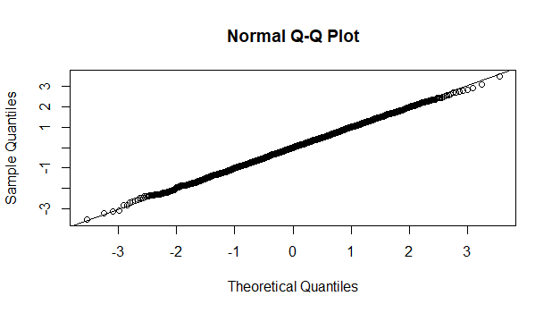
Q-Q Plot

Slide 19
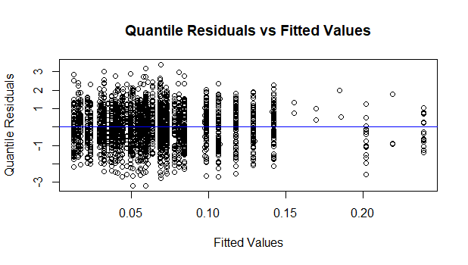
Fitted values vs Quantile Residual

Slide 20
Odds Ratio
> print(odds_ratios)
(Intercept) GenderMale Country2 Country3 Country4
0.04456185 0.80631426 3.71425341 0.35603158 1.76290516
Country5 Country6 Country7 Country8 Country9
3.32023631 0.87189112 1.29415180 1.05101203 1.49748521
Country10 Subscription2 Subscription3
0.92866955 1.37986477 1.89923987

Slide 21
Goodness of Fit(Hosmer-Lemeshow tests)
Hosmer and Lemeshow goodness of fit (GOF) test
data: nf2$y, fitted(nf2)
X-squared = 9.0347, df = 8, p-value = 0.3394
High p-value(>0.05) describes model fits the data well.

Slide 22
Results
According to Score and Likelihhod Ratio test, we say that country, subscription and Gender variables is significant for user retention.
Odds Ratio:
On the otherhand, standard and premium subscribers retention percentage is exponentially 39% and 90% higher than basic subscribers continuation.
Moreover, males subscriber retention rate is exponentially 20% lower than females.
In addition, Brazil, Germany, Italy, Mexio, United kingdom, France subscribers retention rate is exponentially higher than Australia and US, Spain, Canada subscribers continuation rate is exponentially lower than Australia.
There is no influential measures by checking of cook’s distance, DFFITS and covariance ratio and there is no multicollinearity by checking VIF.
Subsequently, the model is adequate by Fitted values against quantile residuals plot and the data follows normal distribution according to Q-Q plot.

Slide 23
Discussions
Netflix should improve their basic subscription plan. They can reshape their pricing and control more ads.
They should rethink the subscription strategy of different countries according their consumer characterize. They can use famous local actors and create content diversity based on different country.
Moreover, they can add various audio subtitle when release contents. Furthermore, the authority can accept subscription payments based on individual country currency.
Netflix authority should focus on content choice variety by gender.

Slide 24
Model Improvement
If there is more variable in the dataset related to content (Genre, Runtime), then it may be impact the model significancy.
Response variable is highly imbalance data, so random forest model or gradient descent model can be effective.

Slide 25

Any Questions???

